Slide 1
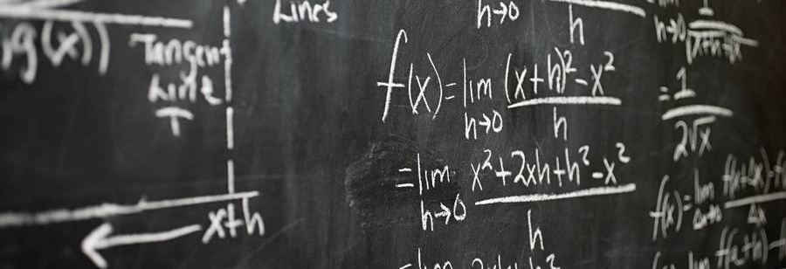
Identifying Misconceptions in Math: A Learning Journey
William Vincent

Slide 2

Introduction
Goal of project:
Enter Kaggle competition- Learn and/or Win
Competition Entered:
Eedi - Mining Misconceptions in Mathematics
develop an NLP model driven by ML to accurately predict the affinity between misconceptions and incorrect answers (distractors) in multiple-choice questions. This solution will suggest candidate misconceptions for distractors, making it easier for expert human teachers to tag distractors with misconceptions.

Slide 3


Quickly realized, I was behind in a few ways.
Top performers attributes:
Polars vs Pandas
Using Big Pretrained Models
Ensemble via Combining Vectors
Environment Management

Slide 4

I figured.
I wasn’t winning this time. Not against large pretrained models, that entire teams worked on for much longer.
So
It’s Learning Time

Slide 5
So, let’s learn from who is in the lead
Kaggle user: yourlh
Current model score: 0.3

Slide 6
Goals of Project
Goal 1: Understand and recreate methodology
Goal 2: Make a usable Version of the ensemble model
Recreate the polars code to pandas
Learn how to work with pre-trained models
Learn the method used to ensemble them
Create a pipeline or class that can take in new data and create a prediction
Create a prototype with streamlit

Slide 7
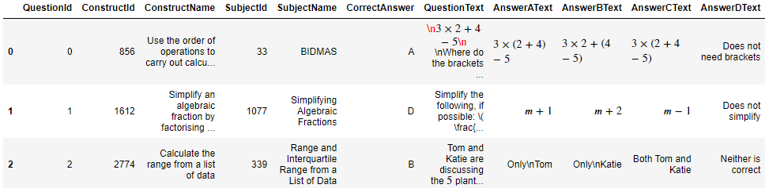
The Given Data
The Test/Train Data Structure:
QuestionId & QuestionText
ConstructId & ConstructName
SubjectId & SubjectName
CorrectAnswer
Answer{A,B,C,D}Text
Misconception {A,B,C,D}Id
Misconception Map
MisconceptionId
MisconceptionName

Slide 8

The Methodology

Slide 9
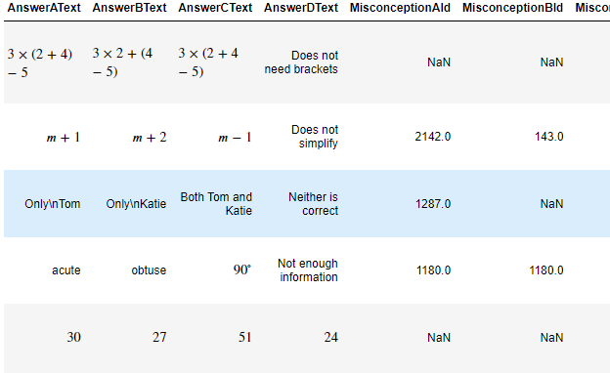
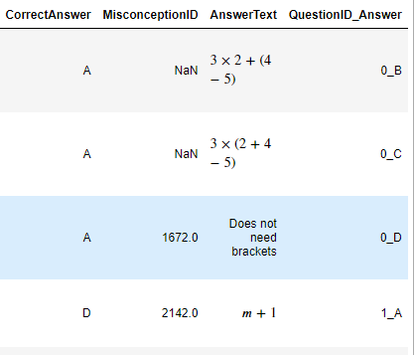
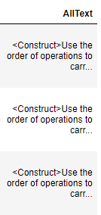
Data Cleaning
Pre-trained models do not need the training data.
Will be used for samples later
Expand the data for each unique answer instead of each unique question
Add a column containing all text from all columns

Slide 10
Models used for Encoding/Vectorizing
BGE
Created by the Beijing Academy of Artificial Intelligence (BAAI).
GTE
a general-purpose text embedding model trained with multi-stage contrastive learning
MPNetV2
Produced at Cornell University
Uses Flag embedding for retrieval, classification, clustering, or semantic search
Developed by Microsoft
maps sentences & paragraphs to a 768 dimensional dense vector space and can be used for tasks like clustering or semantic search.

Slide 11
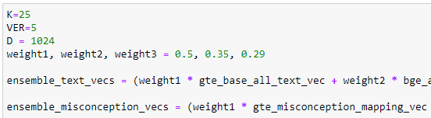
Encoding Data & Ensemble Vector
All pretrained models are accessed on Hugging face using the SentenceTransformer function.
Both the text data from the test data and the misconception map are encoded on each of the models used.
Then we combine each of the models vectors into a single vector, giving a weight for each model.

Slide 12
F.A.I.S.S.- the key to this ensemble
It is used to take the ensemble vectors of both the test data and misconception map and find the most similar data to the vectors given.
We use it to return a np.array of indices that correspond to the ID numbers in our Misconception map

Slide 13
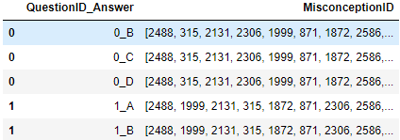
Submission for Contest

Slide 14
Making it Usable

Slide 15
A Lesson in Scope
Original goal
Original Compromise
What I produced
Have a workable app on stream lit that let you put in a question and an answer and output a list of possible misconceptions.
Create a Pipeline in a Jupyter Notebook that would take all the text (QA, subject, construct, etc.) and output a list of possible misconceptions.
I made a class that replicates the methodology of this competition entry and output a list of possible misconceptions.
I also produced a starting point to make a class that streamlines ensembling nlp models.

Slide 16
Output of Predict Function

Slide 17



Pros and Cons and Potential
​Pros
Let’s you predict unknown text on the map provided
Certain functions have improved efficiency by making parts only have to run once.
Cons
Currently only works for a very specified used case
Model has relatively poor performance
Potential
Making a class that lets you use any model available on HuggingFace and any dataframe to make predictions based on a pre-defined map

Slide 18

Thank you
William Vincent
William.preston.Vincent@gmail.com
https://www.linkedin.com/in/william-vincent-81673214a/
https://github.com/WilliamPVincent

